Slide 1
Architecture and Design Presentation
SplitSmart | Ryan Klingensmith & Dominic Baughman | CIS 376

Slide 2
Introduction

Slide 3
Purpose
This presentation and its accompanying document provides a full architectural overview of the software and demonstrates the full breadth of the system through a variety of cases. All architectural decisions made for the system are represented here.

Slide 4
Scope
This presentation and its accompanying document applies to the SplitSmart application co-developed by Ryan Klingensmith and Dominic Baughman

Slide 5
Architectural Representation
This presentation and its accompanying document presents the architectural representation as a series of views:
Use Case View
Logical View
Deployment View
Size and Performance View
Quality View

Slide 6
Architectural Goals and Constraints
Several key requirements for the architecture of the system are as follows:
System should be able to handle intended and unintended spikes in traffic
Track real currency transfers and interface with necessary software to do so
Fully operational mobile and web applications
All other requirements in other documents must be considered

Slide 7
Use Case View

Slide 8
Use Cases
The following items are considered use cases for the SplitSmart application. Those that appear as underlined are significant to the architecture:
Create User Account
Login to User Account
Create Group
Manage Group
Create Expense
Accept Expense
Decline Expense
View Reports

Slide 9
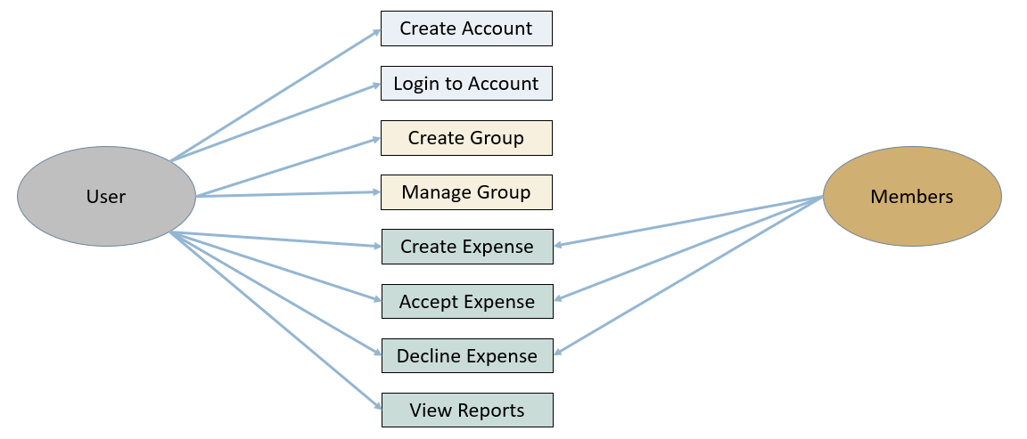
Use Case Diagram

Slide 10
Significant Use Case Descriptions (1)
Create User Account
Register and establish personal accounts within the application. Users are prompted to enter their brief personal details and create login credentials. The user must create an account in order to login and use the application.
Login to User Account
Allows registered users of the application to securely access their personal accounts via their login credentials. Users are prompted to enter their account credentials to login to the application. Successful login grants the user the ability to access and use the application as intended.

Slide 11
Significant Use Case Descriptions (2)
Create Group
Allows users to create groups in which expenses can be shared between members. Users are prompted to enter the usernames of desired members or select them from a dropdown menu. Users will be able to create shared expenses and track payments.
Create Expense
Allows users to create expenses and monitor corresponding payments within the desired group. Users can adjust settings and informational fields, as necessary. Expenses will then be subject to review by applicable parties.

Slide 12
Significant Use Case Descriptions (3)
Accept Expense
Allows users to accept pending expenses created by other users and handle payments accordingly. After accepting expenses, payments will be automatically processed, sent, and summarized within reports.

Slide 13
Logical View

Slide 14
“User” Class
Attributes
Methods
Username
Password
Email
D.O.B.
Address
Preferred Currency
Date Joined
createAccount()
logInAccount()
logOutAccount()
editProfile()

Slide 15
“Group” Class
Attributes
Methods
Name
Members
Payment Ratios
Date Created
Notification Settings
createGroup()
manageGroup()
leaveGroup()
changeSettings()

Slide 16
“Expenses” Class
Attributes
Methods
Amount
Description
Date
Status
Creator
Notes
Category
createExpense()
acceptExpense()
declineExpense()
cancelExpense()

Slide 17
Deployment View

Slide 18
Glossary of Terms
The following terms are represented in the general deployment of the SplitSmart application and its corresponding software and hardware devices.
“Mobile Device” – any android or iOS device with the ability to download and run applications
“App Store” – applicable hosting store where the SplitSmart application can be downloaded from
“Cloud Server” – any hosting service where the SplitSmart infrastructure can be deployed
“Database” – central repository for storing and managing data required by the SplitSmart application

Slide 19
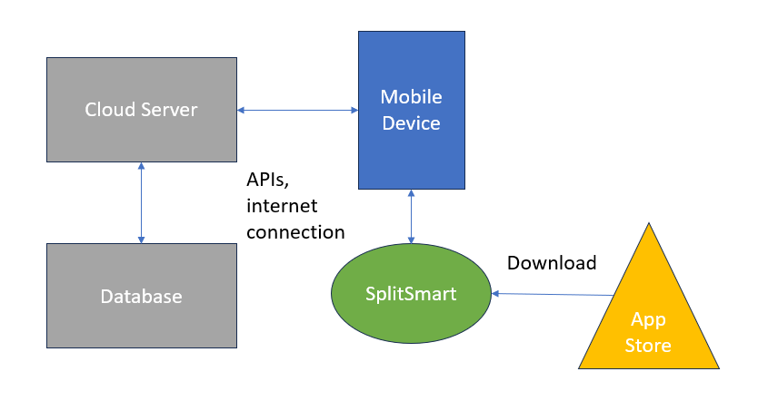
Deployment Diagram

Slide 20
Size and Performance

Slide 21
Size and Performance
The SplitSmart application will be designed in a modular way that allows for easy and manageable scaling as necessary depending on the numer of users and the total bandwidth required for constant, high-level operation and availability.
While an exact estimate of desired possible users is unknown, we hope that 25,000 concurrent users will be able to utilize the SplitSmart application.

Slide 22
Quality

Slide 23
Quality
The software will be designed with high quality and functionality as the focal point of our development.
Its performance will be on par with or exceed common competitors currently on the market in terms of functionality, performance, efficiency, usability, and resource allocation.

